Slide 1
“Educating Today for Tomorrow’s Workforce”
Northern Tier Career Center
Notes:
Welcome and introduction

Slide 2
Past
Job Skills
Present
College Readiness & Career Pathways
Future
Next Steps
“Career Center”-Career & technical education (CTE)
BOTH/AND opportunity for ALL students
Academic, technical, and employability skills
Multiple pathways to career AND post-secondary education AND military
Industry credentials
College credits at no cost to students
SOAR articulation & PennCollegeNOW & Penn State dual enrollment
Cooperative education work experience
Continue to work with all 8 sending districts to identify needs for additional pathways & program clusters
Collaborate with business, industry & community to meet workforce needs
Expand opportunities for industry credentials & college credits
Explore additional adult education opportunities
“Vo-tech” school
Traditional vocational education
Specific students & track
Training for specific occupation
Pathway directly to job
Notes:
In 1974, the school districts in Bradford and Sullivan Counties came together and bought a 77 acre campus to develop the Northern Tier Career Center. The Center is still owned and operated by all 8 districts and provides elective courses (programs of study) in career and technical education fields.
No longer just the “vo-tech” of the past, offering training for direct entry to workforce. Now also incorporates additional opportunities (see slide)

Slide 3
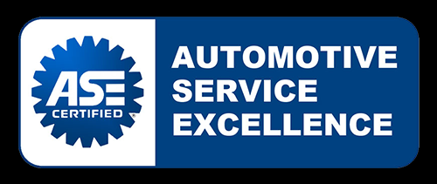
Industry Certifications
Cosmetology
NIMS
CNA
Notes:
These are examples of industry certifications offered at NTCC, which provide students with advantages upon entering the workforce or post-secondary education.
(examples in program slides)

Slide 4
4 SKILLS
Academic Skills
& Knowledge
Employability
Skills
Life Skills
Technical Skills
https://www.youtube.com/watch?v=oDDeptNUqZ4
Notes:
All of our programs incorporate all 4 skills.
Employability is paramount; communication, problem solving, attendance, safety, on-task, work completion, cooperation, etc.

Slide 5
College Credits at NTCC
Wilkes-Barre
Notes:
College credits through dual enrollment with Penn College and Penn State Wilkes-Barre (IT only). Articulation agreements that allow colleges to give credits for successful completion of program at the Center. Saves students money and time.

Slide 6
Penn College NOW Dual/Concurrent Enrollment
Offered in 6 NTCC Programs of Study
Food Production, Pre-Nursing, Machine Tool Technology, Building Construction, Diesel Mechanics, Welding
2017 & 2018: 448 Penn College credits earned at NO COST to students
Families SAVED $242,063 in tuition
Notes:
Review slide. No cost to students.
Recent graduate of welding:
Destiny: entered Penn College for welding engineering as sophomore due to PennCollegeNOW credits earned at the Center.
Credits are directly transferable to all 14 state universities in PA and Penn State, as well as many private institutions.

Slide 7
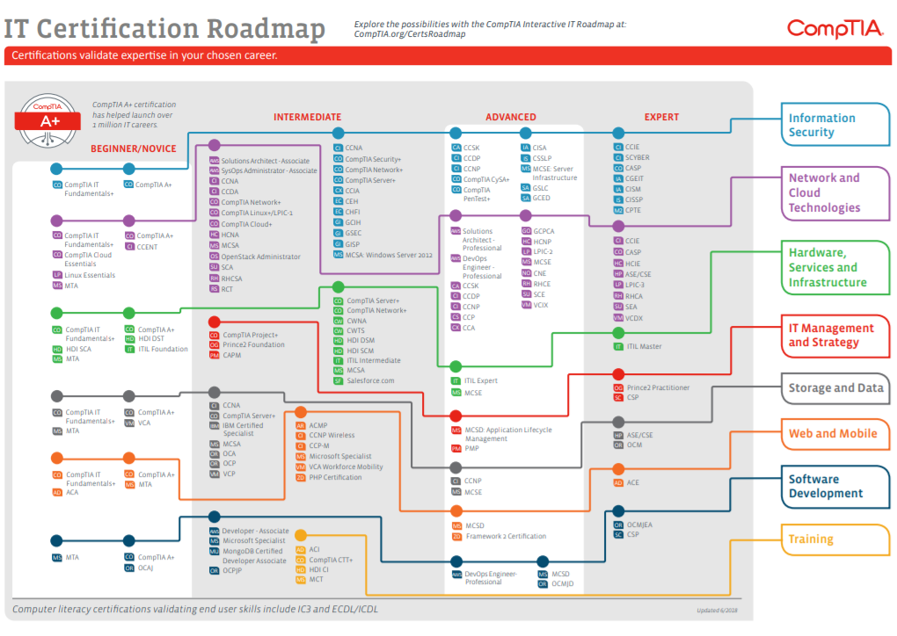
Notes:
Certification roadmap. Certifications earned in all programs at NTCC are the foundation in each field. This is an example of how a student can build upon that foundation and work toward their individual career goals.

Slide 8
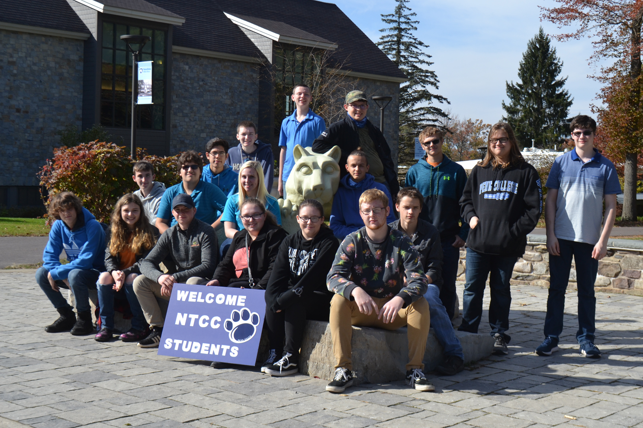
Information Technology
New 2018-2019
Wilkes-Barre
Dual/Concurrent Enrollment
IST Certificate
(Information Technology)
12 credits----$100/credit
Notes:
Dual enrollment, 12 credit IST certificate program through Penn State Wilkes-Barre. Only agreement of it’s kind and only place where a student can get a Penn State credit for only $100. Fall semester 2018 students earning 42 credits at a savings of over $20,000.

Slide 9
Northern Tier Career Center
Pathways
Health & Human Services
Cosmetology
Food Production & Management
Pre-Nursing
Machine Tool Technology
Welding
Building Construction
Mechanical Trades (HVAC, Plumbing, Electrical)
Automotive Mechanics Technology
Collision Repair Technology
Diesel Mechanics Technology
Information Technology
IT
Manufacturing
Trades
Transportation
Next Steps
Notes:
NTCC offers 11 OPTIONS for programs of study and is currently seeking to add programs based on high priority occupations and YOUR interests.
Examples of what we do not offer (taken at high school): arts, business, law/criminal justice, sociology/psychology.
Brief overview of clusters that are offered at NTCC.
Additional information about each of our program will be covered in the next few slides, but I can promise you that it will be MUCH better if you see them firsthand. You will have a chance to see each program in action on the day of the tour, as well as ask questions of our instructors and students. Explore the options to see if the Center is a fit for you.

Slide 10
https://www.youtube.com/watch?v=zs6nQpVI164
Notes:
Play video to 3:40
Importance of a carefully considered career pathway
1:2:7 workforce demands

Slide 11
Outcomes
Options
Opportunities
Notes:
Beginning with the outcomes YOU choose for your futures, our goal is to provide you with options and opportunities to achieve them. The following are some examples of what NTCC can do for you.

Slide 12
BOTH/AND
High school courses AND ½ day elective at NTCC
Build knowledge AND skills
Participate in YOUR high school sports & activities AND NTCC activities (SkillsUSA, National Technical Honor Society, etc.)
Receive high school diploma AND complete NTCC program with industry certifications
Notes:
There are many myths surrounding career and technical education, which used to be an either/or option. It is now BOTH/AND opportunity for students. Essentially, NTCC is an extension of your high school. Instead of taking all of your electives at school, you can choose to take a ½ day elective in one of our programs for your junior and senior years.
(Highlights from slide)

Slide 13
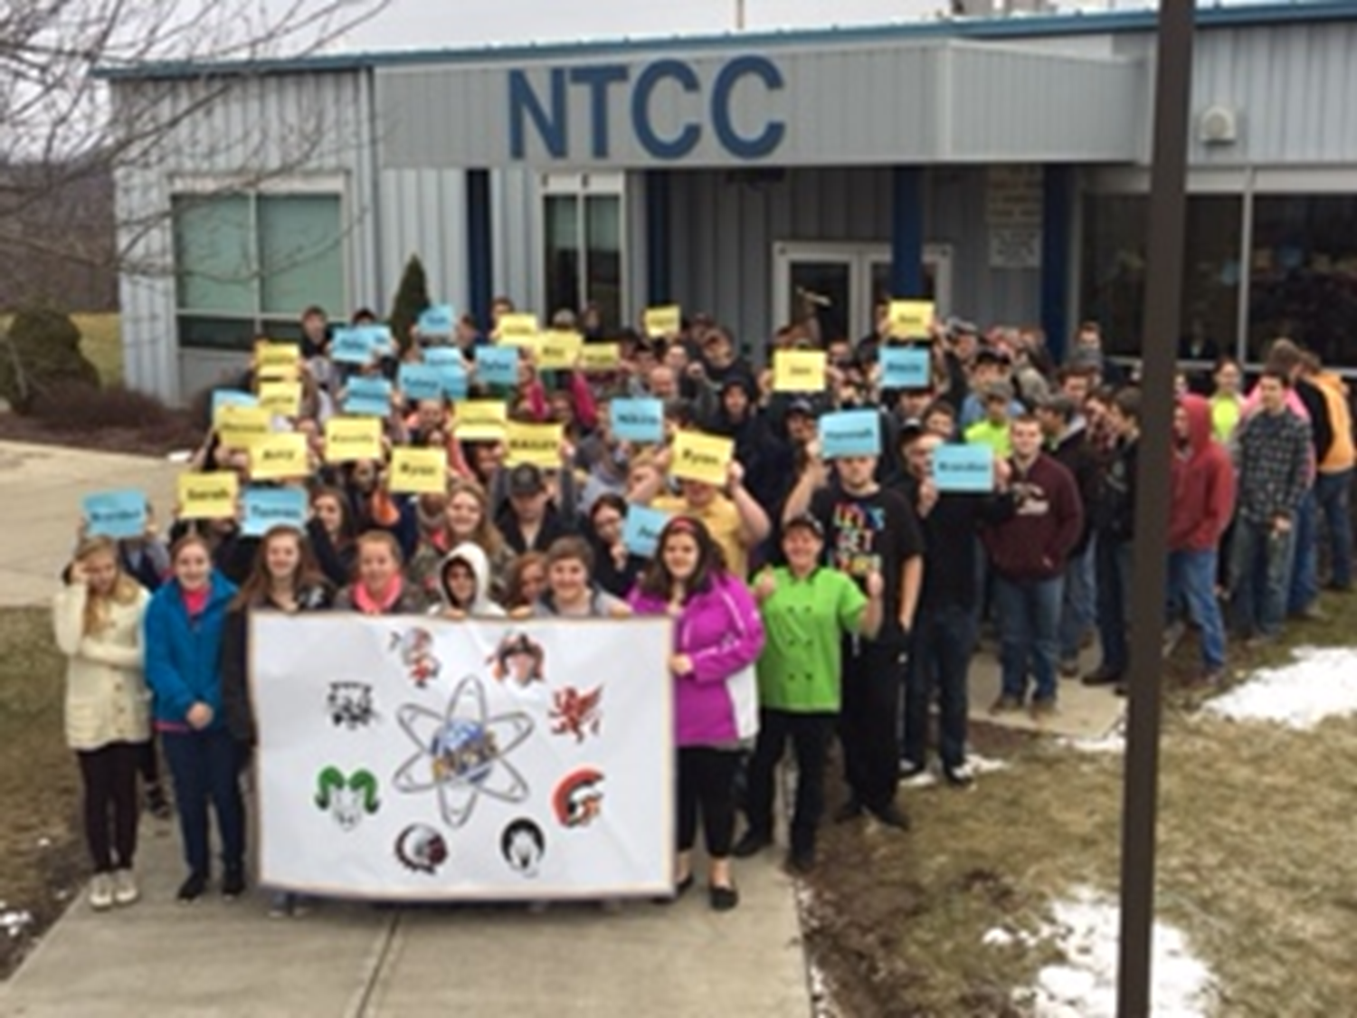
Notes:
These are some of the opportunities available to NTCC students, in addition to those offered at your high school.

Slide 14
Career Plan & Pathway
Career Goal
Idea
Notes:
You may have a career goal in mind. You may have no idea. You may know what interests you and what you’re good at. You may still be trying to figure it out. That’s all okay and it’s why our goal is to provide you with options and opportunities to reach the outcomes YOU choose for your future.
Whatever you choose, my advice is that you don’t limit your options. Explore ALL of the opportunities. Spend a few hours with us to tour the Northern Tier Career Center to see if it might be a stop along your career pathway that can help you get to the future YOU want.
There is no substitute for seeing for yourself. Just as you should job shadow to decide on a career and visit a college campus before deciding where to attend. The decision whether or not to attend NTCC is important. Deciding to complete a program of study at the Center is a commitment, but so is deciding not to attend, as you many miss out on important opportunities provided for your chosen career pathway.

Slide 15
College
43%
Career
50%
Military
7%
Apprenticeship
Notes:
Whether your career pathway will take you to college (post-secondary training and education), directly into a career, or the military, NTCC programs can help to prepare you by offering opportunities to earn college credits and industry certifications to give you an advantage in the workforce.
2018 seniors: 43% college, 50% career, 7% military plans
Apprenticeship is becoming a more popular way to get the training and education necessary in your field. Employers hire skilled employees, who are paid for their work AND the employer pays for all additional training needed.

Slide 16
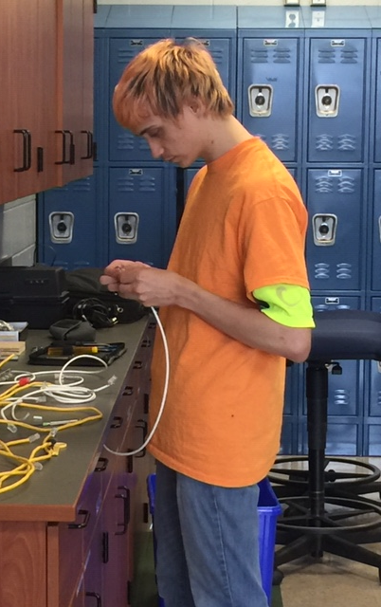
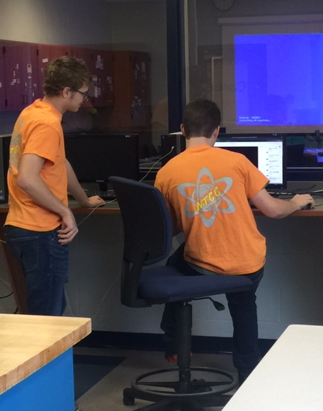
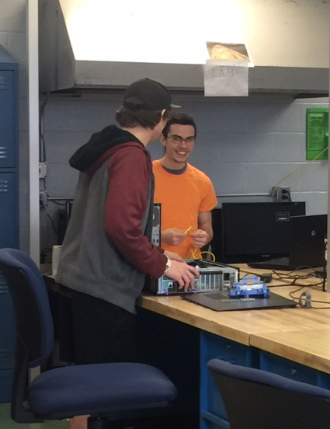
Information Technology
Notes:
New in 2018. Added to meet industry demand and interest of districts and students.

Slide 17
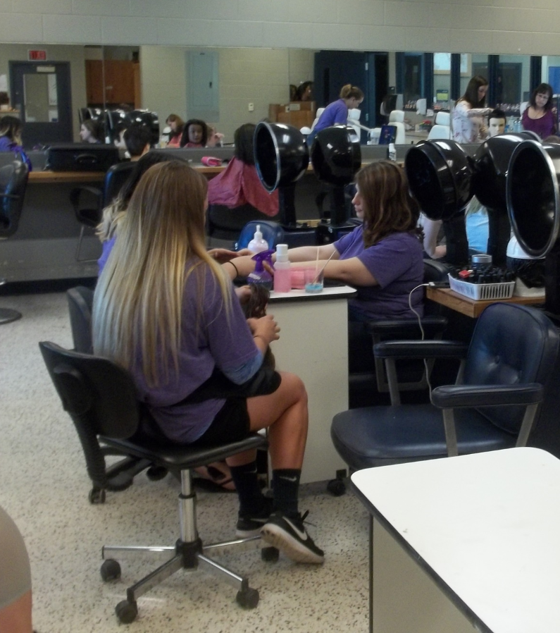
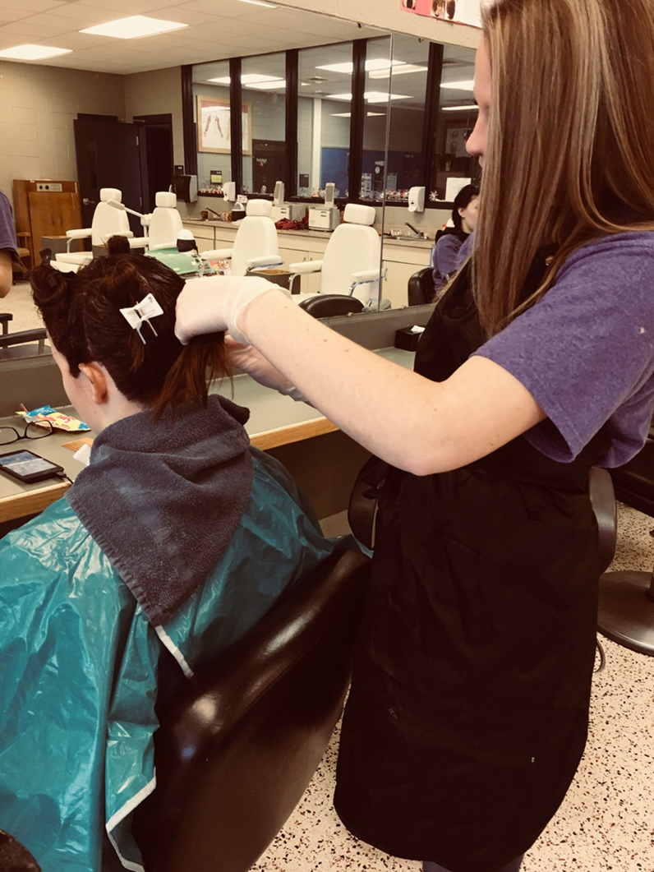
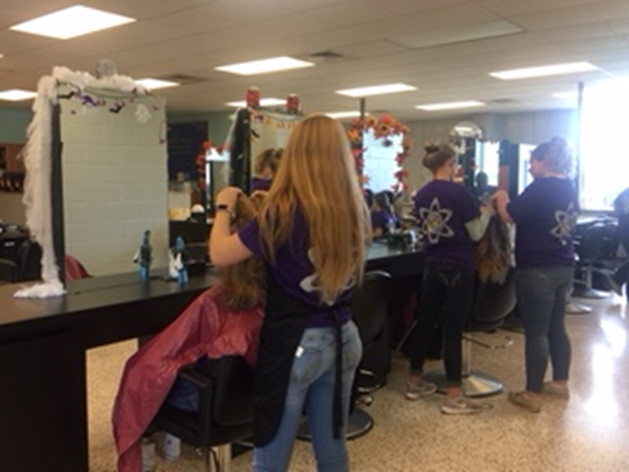
Cosmetology
Notes:
Only program that starts as sophomore. 1,250 hours to complete PA licensure. Licensure REQUIRED to practice in PA. Same curriculum as adult programs, but would cost approx. $20,000 to complete after high school.
Continuous improvements to keep up with industry standards. 2018 salon renovation approx. $30,000.
Live work-all programs-salon clinic operated by students and open to public
Recent grads:
Stacey: attending college in NYC for esthetics
Courtney: owns salon in Troy (ENTREPRENEURSHIP in all programs)
All who want jobs once licensed have been successful in getting hired.

Slide 18
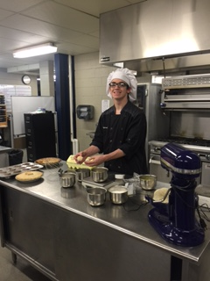
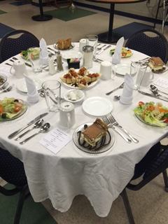
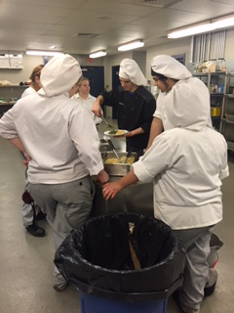
Food Production & Management
Notes:
Culinary arts and baking
Student operated restaurant on campus-Blue Fountain Café
Caterings for 10-350 people
Recent grads:
Ray-at Culinary Institute of America to become a chef (review non-traditional definition)
Noelle-chef in Navy, completed basic and stationed in San Diego, CA
In college, working in restaurants, hospitals, catering companies, bakeries, etc.

Slide 19
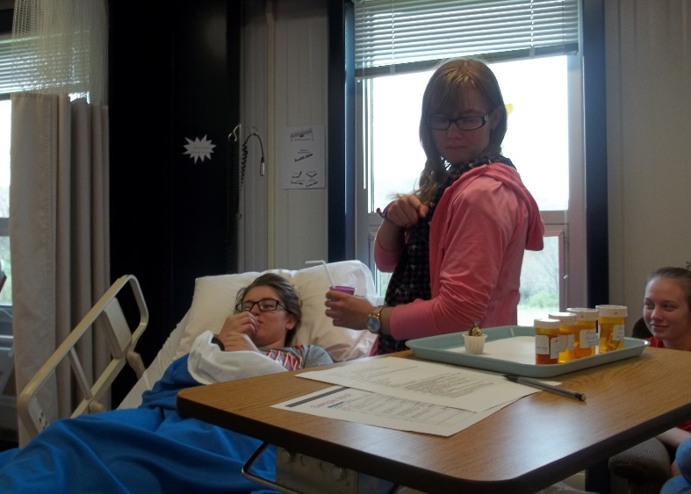
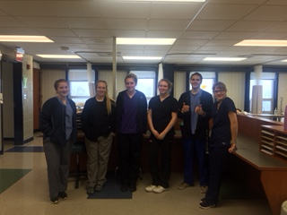
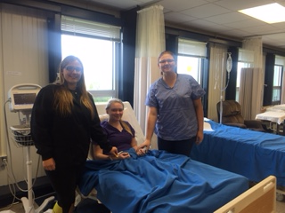
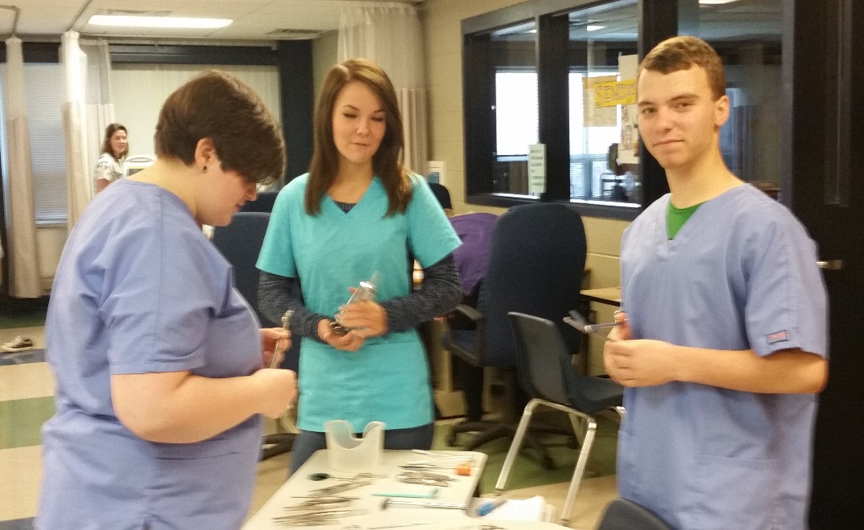
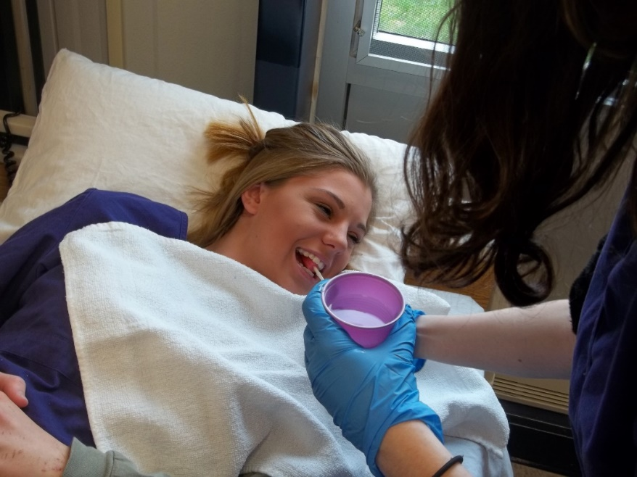
Pre-Nursing
Notes:
A consideration for anyone intending to enter the healthcare field (nursing, physical therapy, occupational therapy, athletic training, dental, medicine, etc).
Industry certification-Certified Nurse Aide (as career or additional $ while in college). College credits year 1.
Pathway: NTCC pre-nursing to NTCC LPN program (1 year and $3,000 scholarship for NTCC students) to RN or BSN program.
Example of student choosing not to attend NTCC: Physician Assistant program at Penn College and now has to complete courses and pay full tuition. Also no CNA certification to work in the field (approx. $15/hour) while attending college.

Slide 20
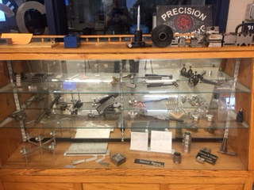
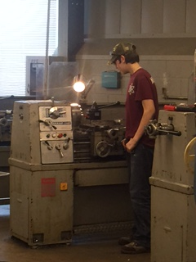
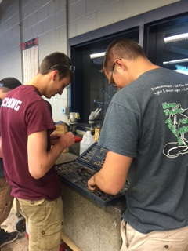
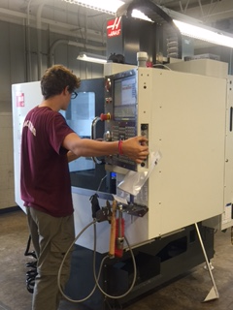
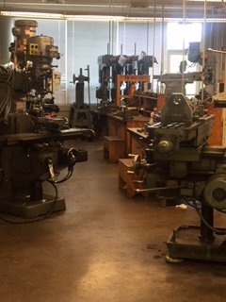
Machine Tool Technology
Notes:
Manufacturing is extremely high demand field! Machinist to mechanical engineers.
Apprenticeship opportunities: PMF manufacturing in Williamsport. Directly from NTCC: 6,000 hours/2 years, start at $14.50 to $23.50 at end, classes one night per week at Penn College paid by PMF, paid to work at PMF, journeyman’s card at end and hired on permanently. If attend college and get degree first, program is exactly the same, including pay.
Mitchell: apprenticeship at E-tech and degree at Penn College, paid by company
Sam: attending the Citadel, prestigious military college
Employers come to us seeking machinists….can’t fill positions.
Operation and programming with CNC-have to see for yourself to understand what this program can offer.

Slide 21
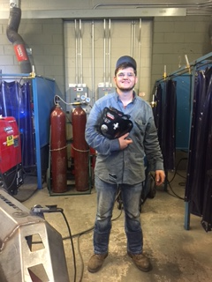
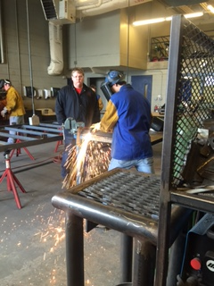
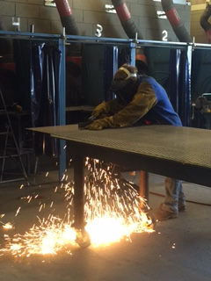
Welding Technology
Notes:
Also manufacturing cluster and in high demand!
Learn several types of welding (stick, MIG, TIG, etc.). Plasma cutter new in 2017. Weld every day in program. NTCC programs are approximately 25% classroom and 75% lab.
Ohio Technical College gives $5,000 scholarship for completing NTCC program.
Recent grads: hired right away based on skills acquired at NTCC.
Penn College NOW—next slide

Slide 22
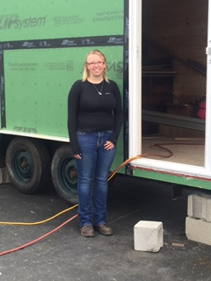
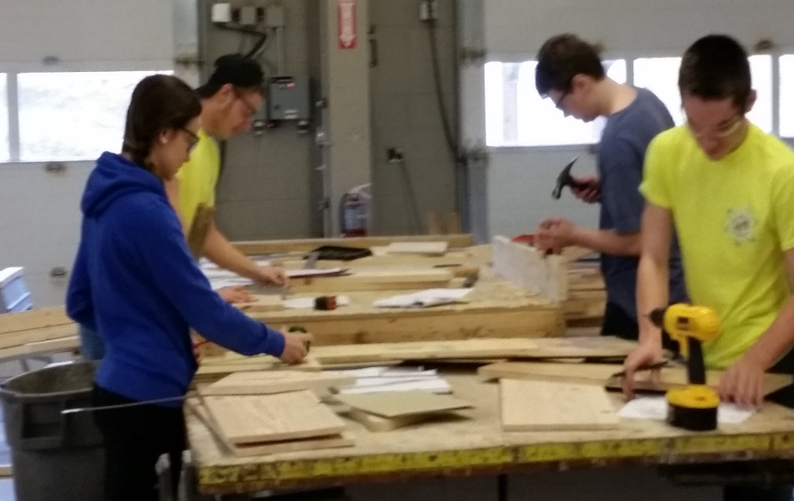
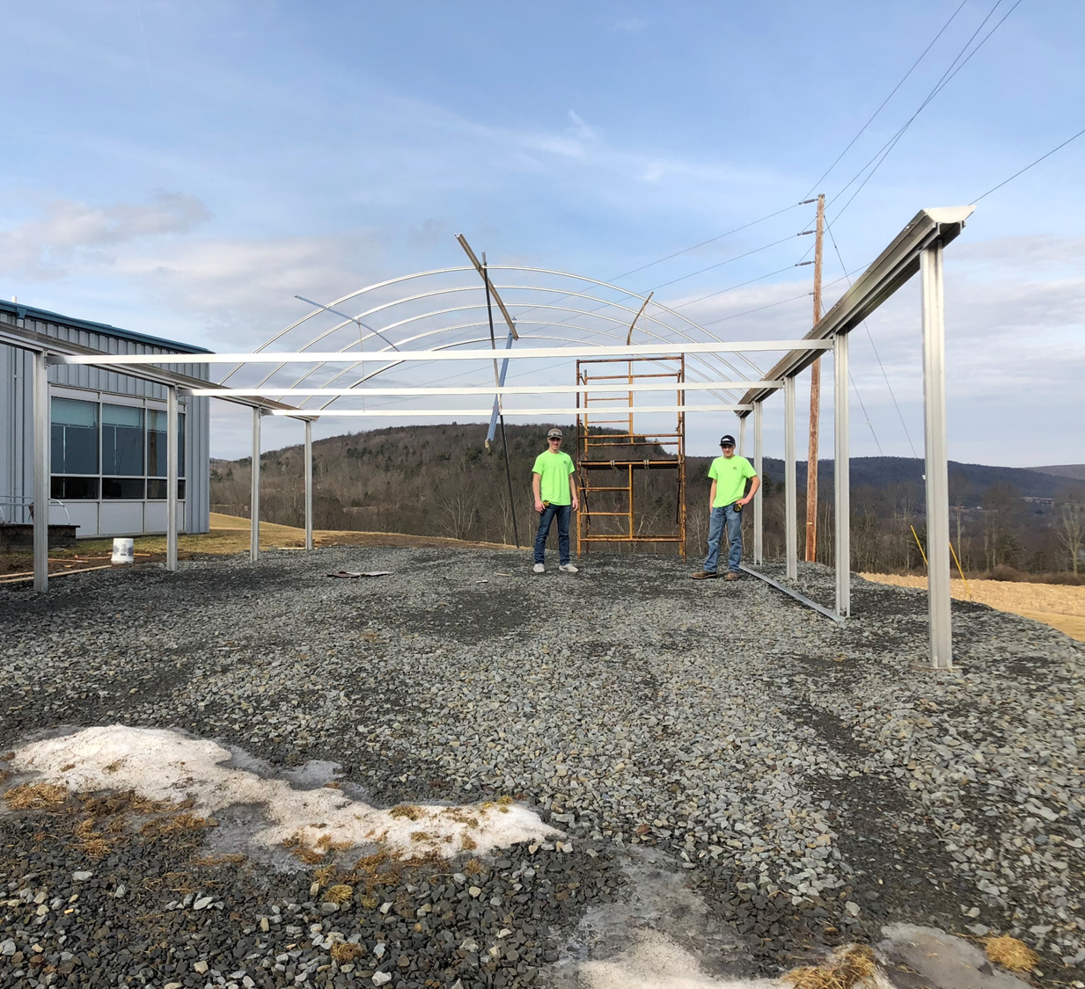
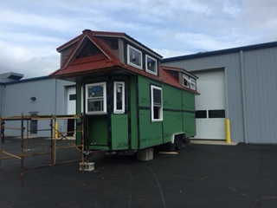
Building Construction
Notes:
Live work-large and small projects. Tiny house, cabins, play houses, tables, cabinets, benches, etc.
Opportunities to work off-site in community (Amvets, Lackawanna College, High Schools)
Provides foundation for multiple pathways: masonry, framing, roofing, flooring, carpentry, self-employed contractor (entrepreneur), architect, construction manager, electrical, planning, construction, engineering, planning and zoning, etc.

Slide 23
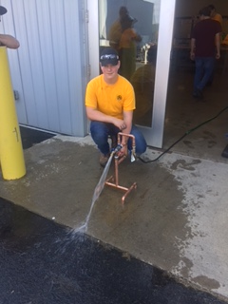
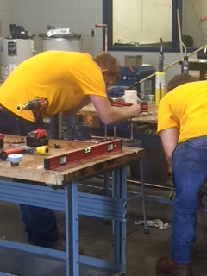
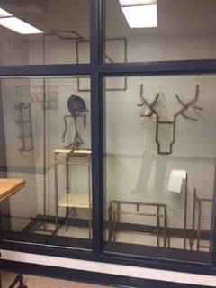
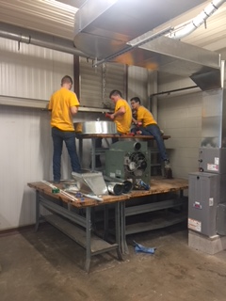
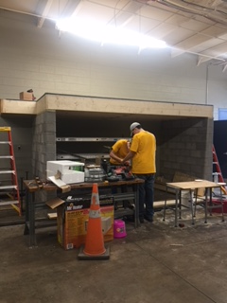
Mechanical Trades HVAC
Notes:
New in 2017, students and instructor “building” the lab-collaboration with building construction program. Quickly grew in popularity at NTCC with wait lists for this year.
Foundation for multiple pathways: residential and commercial heating, ventilation, air conditioning, refrigeration, electrical, plumbing, inspection, planning, etc.
High demand locally and nationally. All students who wanted summer jobs in HVAC had one after the first year.

Slide 24
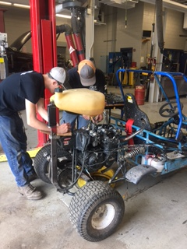
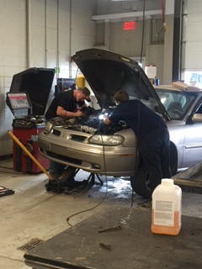
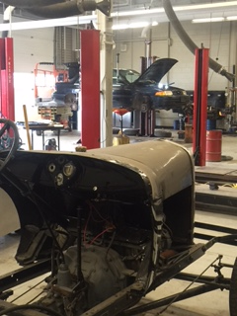
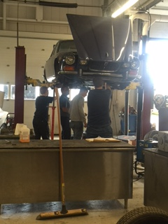
Automotive Mechanics
Notes:
Live work-students run the lab/garage
All facets of engines, systems, vehicle diagnostics and maintenance. Multiple pathways-entry level to master technician. Branch out-example aviation.
Student built own go-cart with skills learned here (picture left)
Industry certification: required for garage to have in order to inspect vehicles. PA Auto Inspection license completed by auto mechanics, auto body, and diesel students at NTCC.
High demand: Williams Auto Group looking to hire 10 techs at one time.
Recent grad:
Dan: hired by Eighmey Buick and they pay for all of his Chevrolet training.

Slide 25
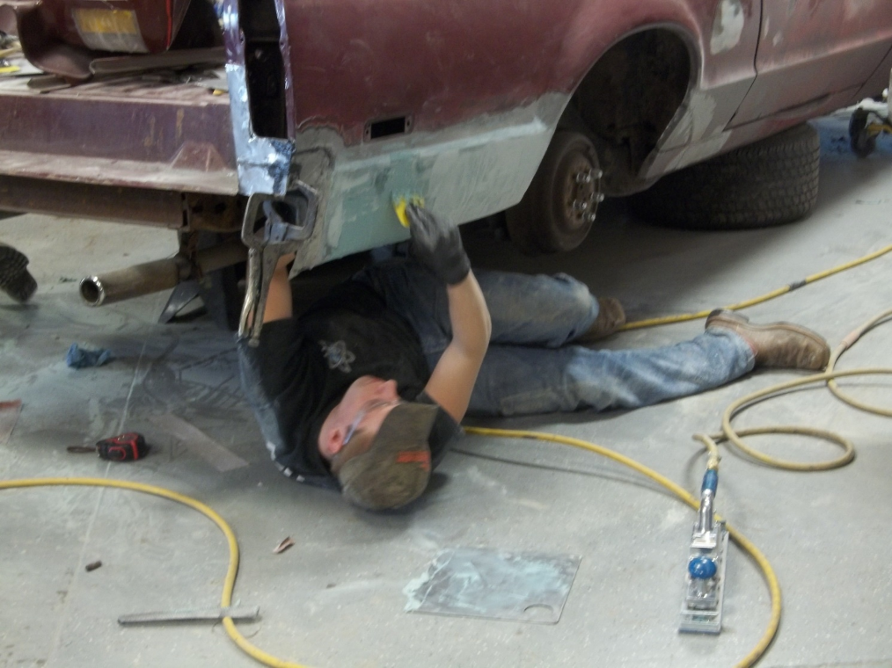
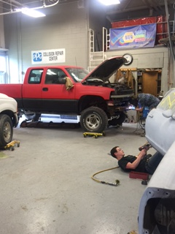
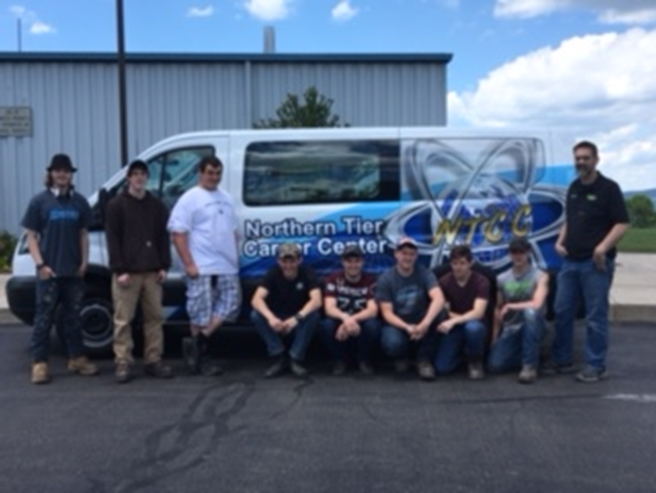
Auto Body Collision Repair
Notes:
Students run the lab/garage in auto body.
Focus on exterior of vehicles and restoration, repair, painting, detailing. Keeping up with industry trends—industry experts come in to demonstrate paint clinic, wrapped van with vinyl with Moose’s.
PA auto inspection license

Slide 26
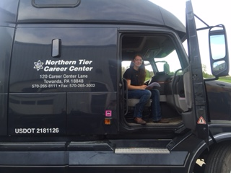
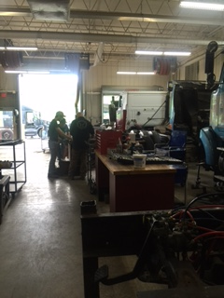
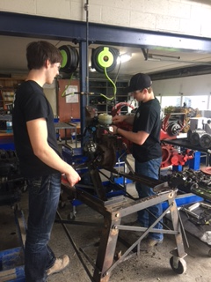
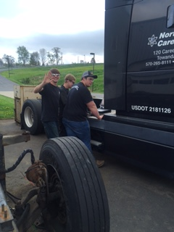
Diesel Mechanics
Notes:
Focus on heavy equipment, farm equipment, trucks, buses, and other diesel engines.
Penn College NOW 4 credits.
Branch out—toured aviation mechanics at Bradford County airport
High Demand: Industry reaching out to us for our graduates: John Deere, CPI for college level gas compression station management program
Cooperative education “co-op”—available in all programs senior year. Work in industry while completing program, rather than every day on site at NTCC. Many diesel students participating: agriculture, diesel shops, PennDOT, etc.

Slide 27
Notes:
(play commercial)
Encourage visit…see for yourself what NTCC can offer you!

